Slide 1
Software Processes

Slide 2
Background
A Definition:
A process (a.k.a. activity) is a collection of related tasks (a.k.a. actions) that transforms a set of inputs into a set of outputs.
Processes and Algorithms:
The set of algorithms is a subset of the set of processes (which, includes, for example heuristics)
Describing Processes:
Specify the inputs to and outputs from the process
Specify the tasks
Specify the inputs to and outputs from each task (a.k.a. data flows)
Specify the order of tasks and the conditions under which they occur (a.k.a. control flows)

Slide 3
Think of a process that you have been through
In terms of:
Inputs to and outputs from the process
Tasks
Data flows - inputs to and outputs from each task
Control flows - the order of tasks and the conditions under which they occur

Slide 4

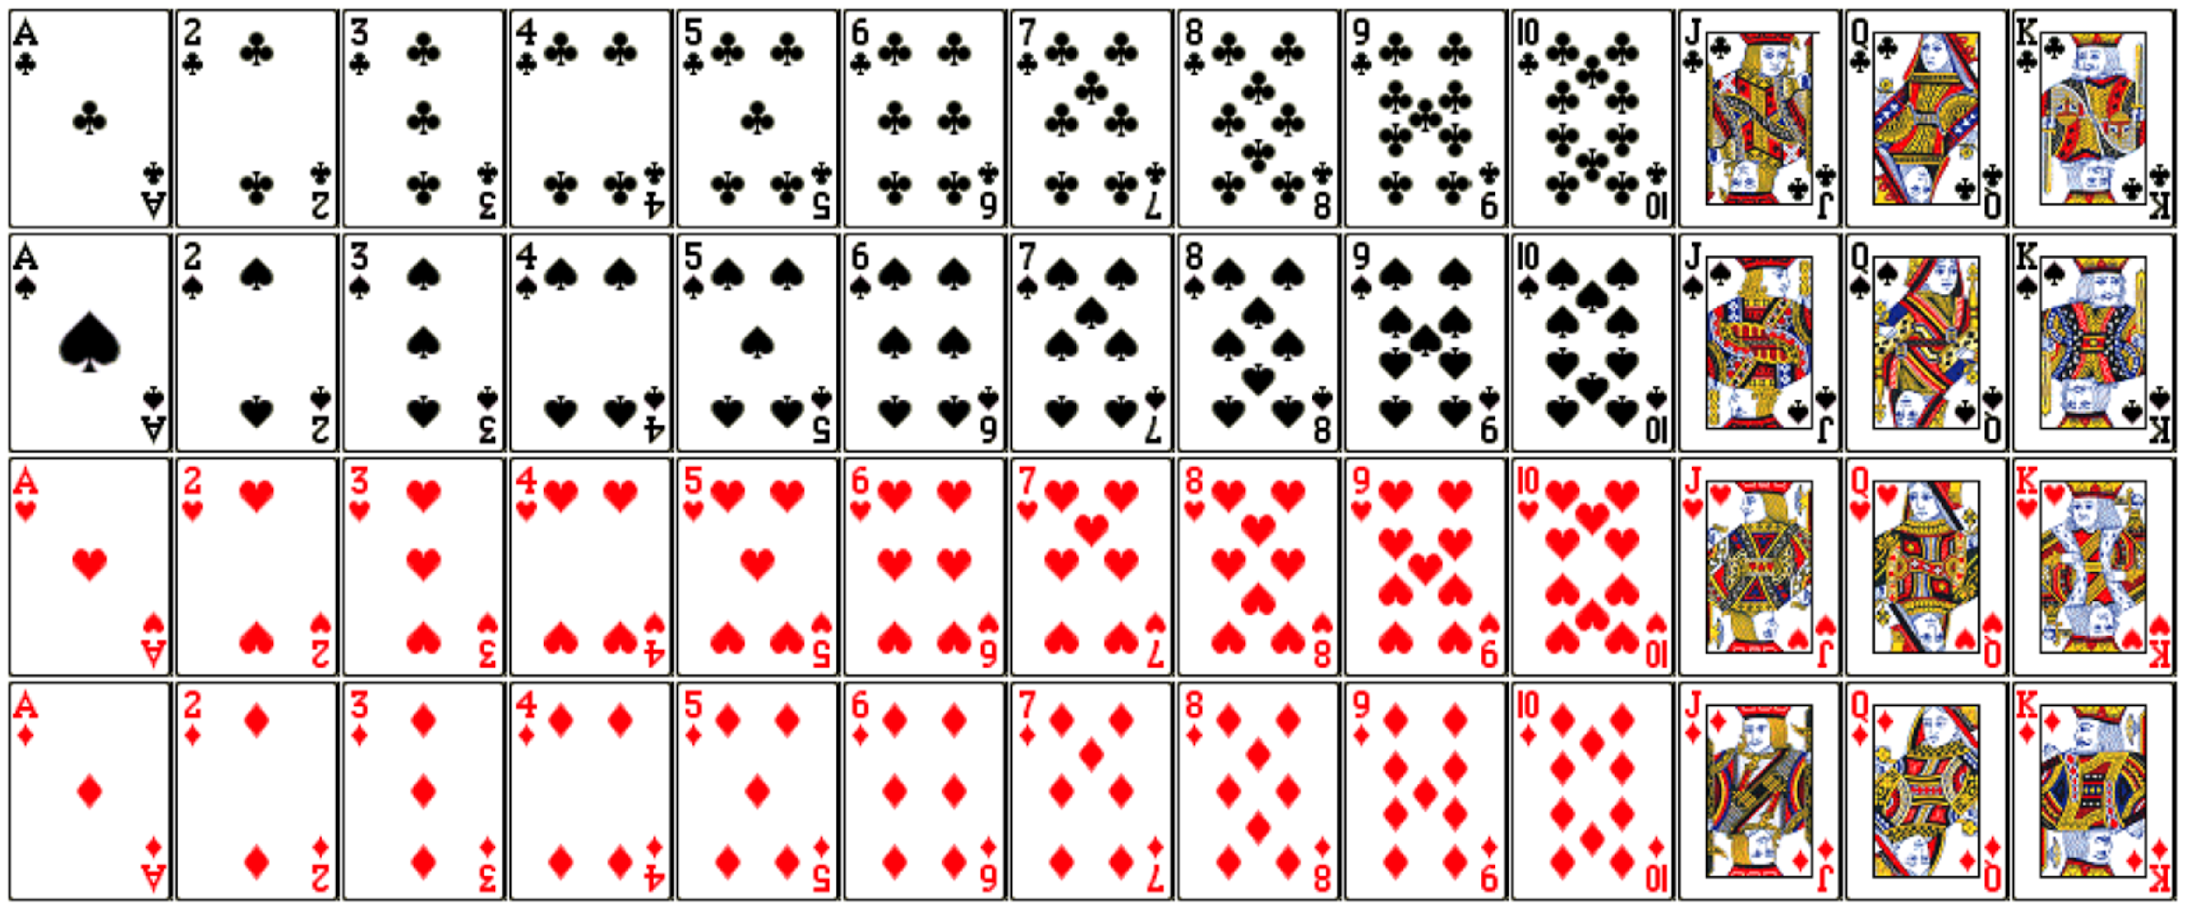
Recall the Card Game…
Input:
Output:

Slide 5







Your Plans – Your Processes
Company Alpha Plans:
Company Beta
C
B
D
Player A can spread and flip cards.
Player B can touch ”Club” only.
Player C can touch ”Spade” only.
Player D can touch “Heart” only.
Player E can touch “Diamond” only.
Order to touch cards: A –> B –> C –> D –> E
Tasks
A
E
?
Control Flow
?
?
Form your own plan.
?
?

Slide 6
Software Processes - Overview
Definition of a Software Process:
A set of actions/tasks (and corresponding inputs and outputs) that results in the specification, development, validation, and/or evolution of a software product
An Observation:
Software processes are very complex and, hence, our discussion of them will necessarily involve abstraction (i.e., we will really be discussing process models)

Slide 7
Common Actions/Tasks in Software Processes
Project Planning:
Financial/economic analysis
Scheduling
Resource allocation
Cost estimation
Risk management
Product Design:
Identification of needs and desires
Specification of requirements
Prototyping

Slide 8
Common Actions/Tasks in Software Processes (cont.)
Engineering Design:
Creation of static models
Creation of dynamic models
Consideration of architectural styles and design patterns
Implementation:
Development
Code/documentation management
Debugging
Verification and validation
Deployment
Support and Maintenance

Slide 9
Problem Solving/Design Actions/Tasks in Software Processes
An Observation:
Many of the actions/tasks in software processes are said to involve "problem solving" and/or "design"
For Our Purposes:
Problem solving and design involve the same (or at least the same kind of) steps

Slide 10
Generic Problem Solving/Design Actions
The Tasks:
Identification of goals, objectives and constraints
Generation of alternatives
Evaluation of alternatives
Selection of an alternative
Categorizing the Actions:
Analysis (to understand the problem)
Resolution (to solve the problem)

Slide 11
Models of Software Processes
As Always:
Since they are models they are simplifications (and some are very abstract)
Types of Models of Software Processes:
Descriptive - what actually happens
Prescriptive - what should (i.e., is supposed to) happen

Slide 12
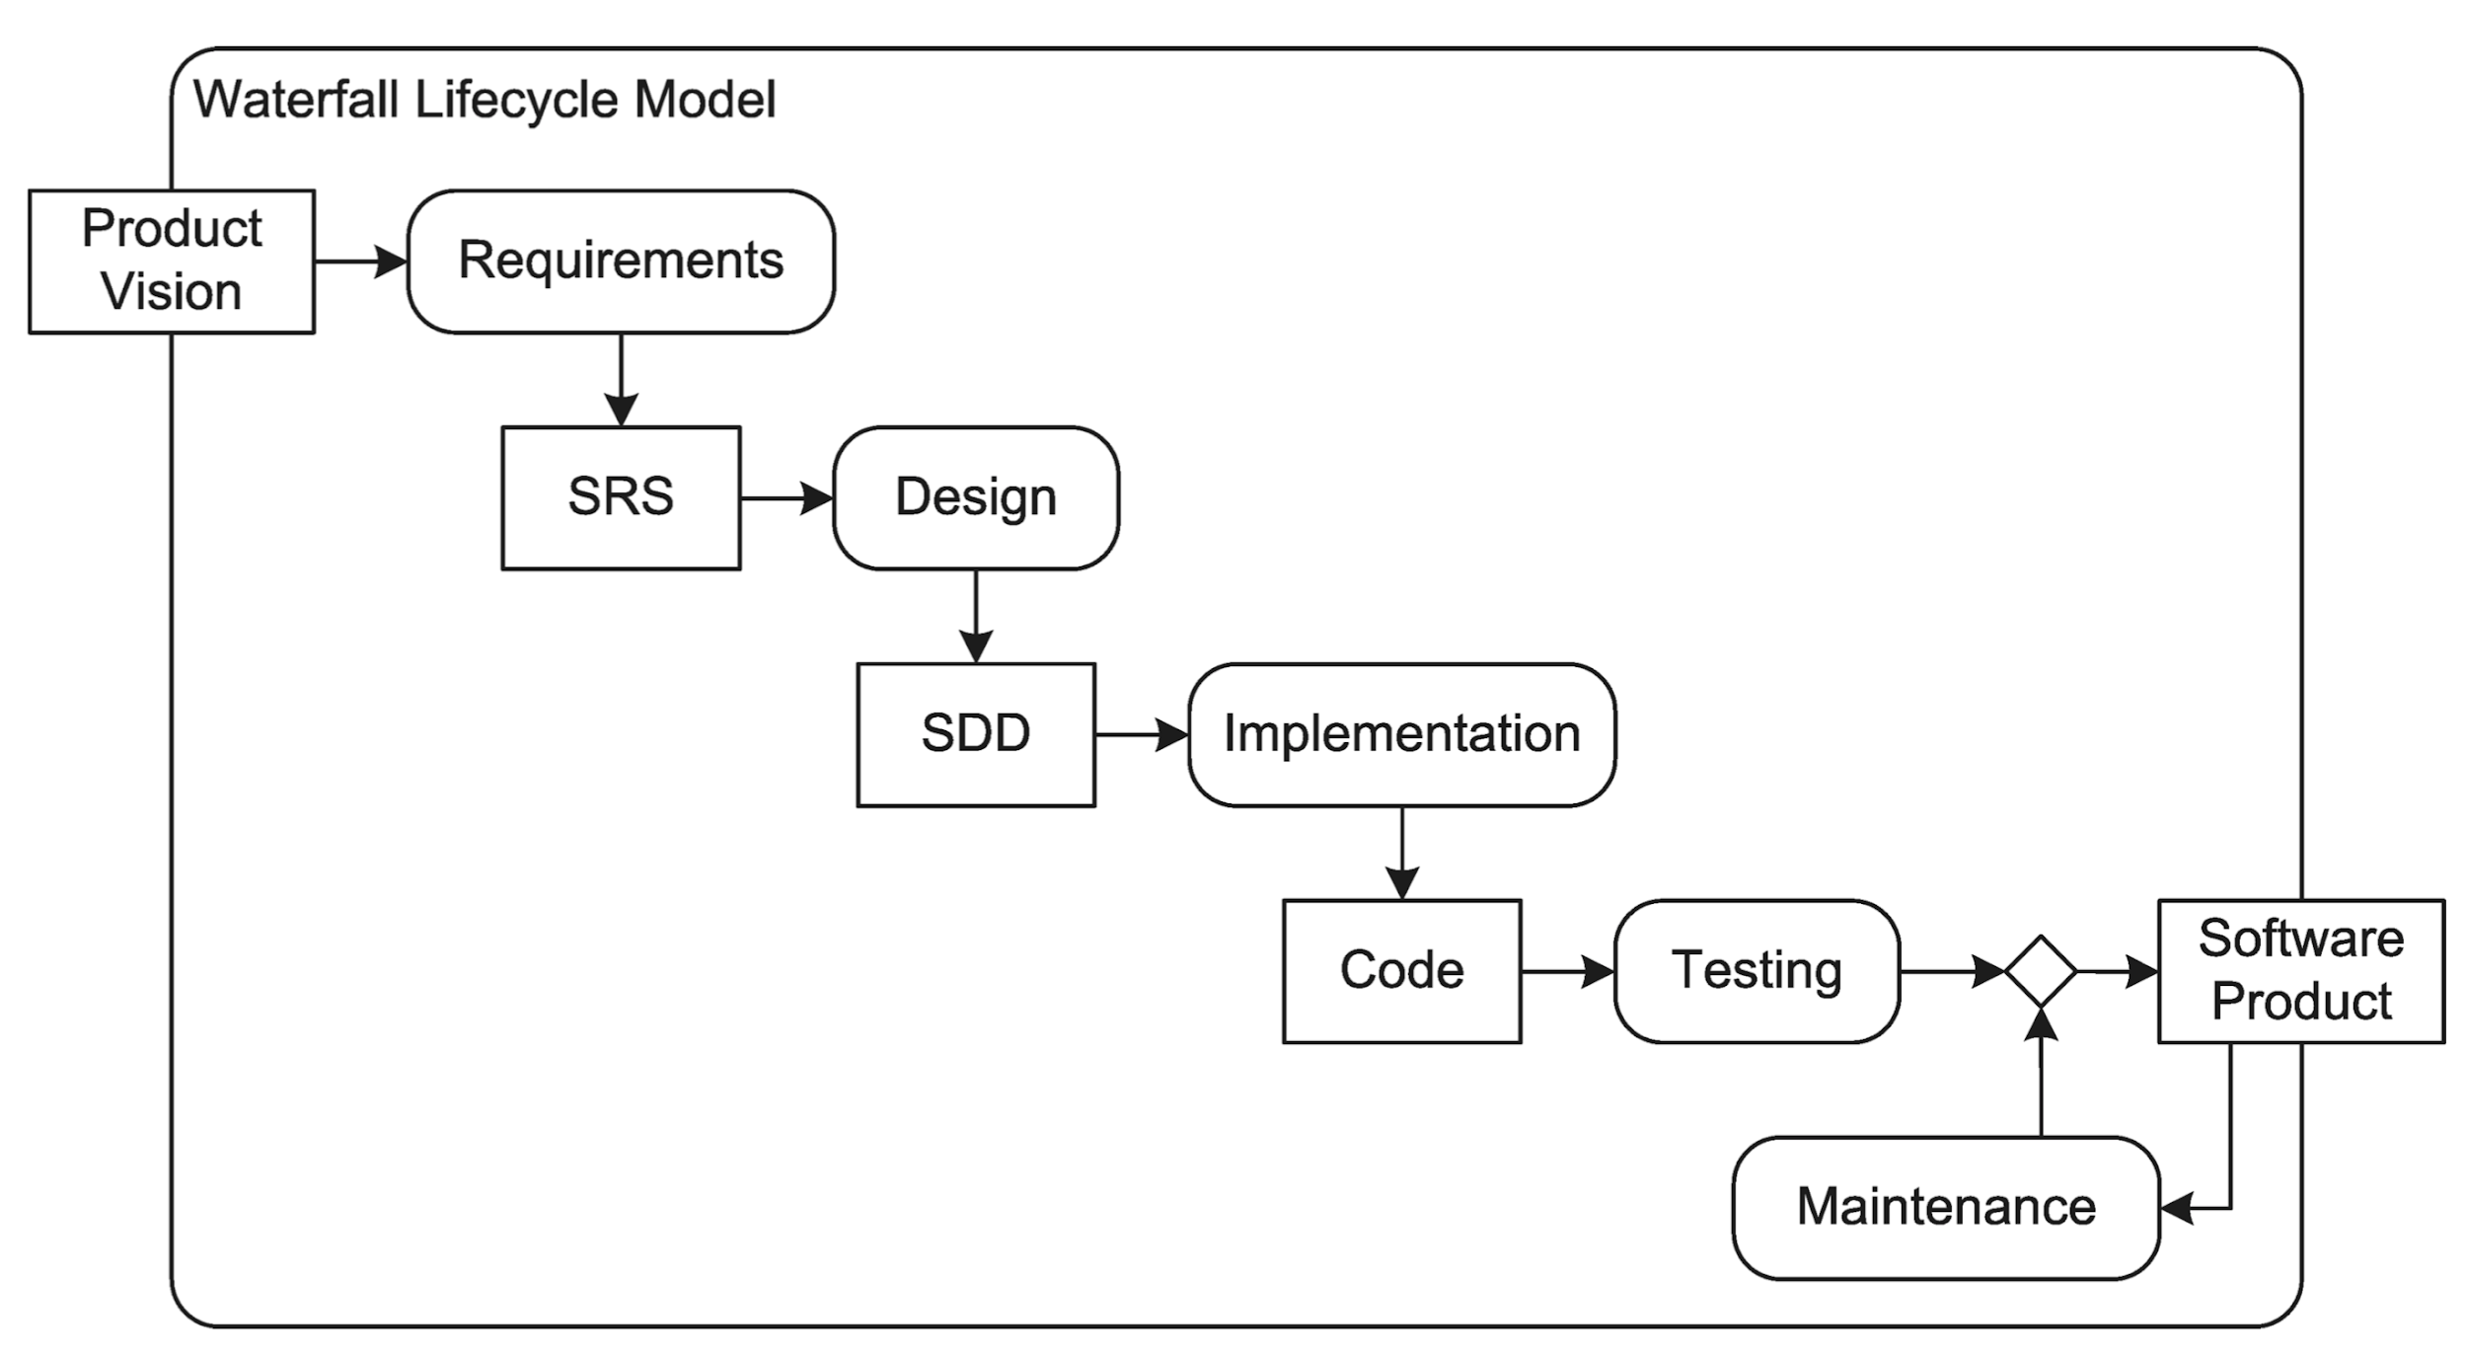
The Waterfall Model
SRS: Software Requirements Specification
SDD: Software Design Document

Slide 13
The Waterfall Model (cont.)
Questions:
Is it supposed to be descriptive or prescriptive?
How idealized/abstract is it?
Pros:
Predictable
Easy to estimate
Easy to fix
Documentation
Distributable
Cons:
Requiring stable Req.
Requiring complete & correct Req.
Documentation
Communication overhead
Management
Taking too long

Slide 14
So the Waterfall model works, but…

Slide 15
Prototyping
A prototype is a working model of some or all of a finished product.
Throwaway prototypes
Evolutionary prototypes

Slide 16
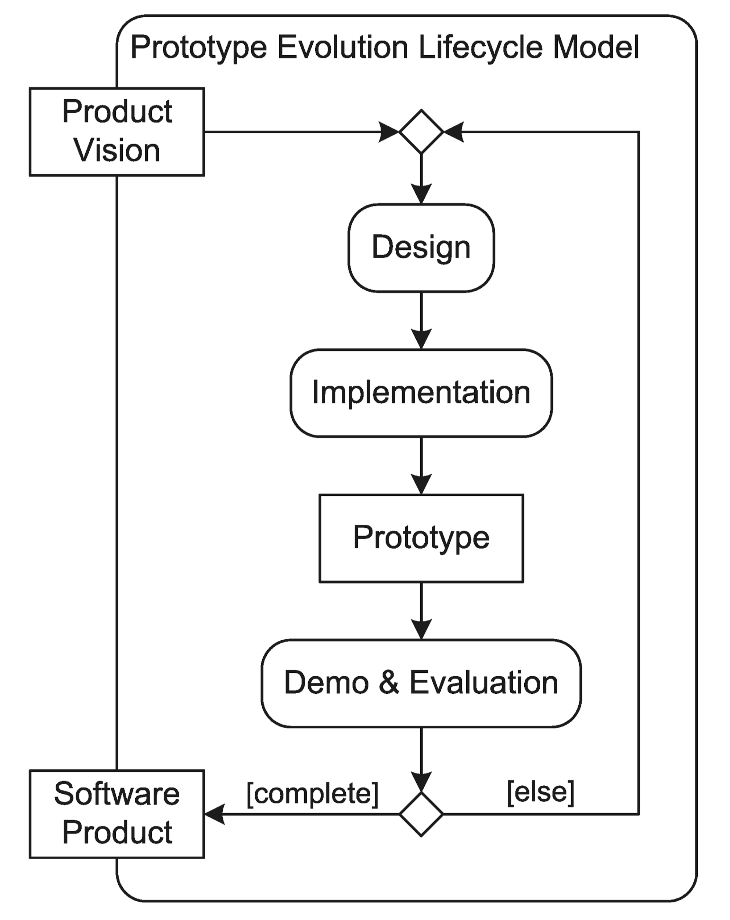
Prototyping

Slide 17
Prototyping
Pros
Easy to handle changes
Getting a working product quickly
Less documentation or management required
Lightweight
Cons
Hard to predict (time & cost)
Product may be unmaintainable
Little discipline -> bad quality control -> buggy product

Slide 18
So customers like prototypes a lot, but…

Slide 19
Risk Management
Risk
An occurrence with negative consequences.
Risk management
The practice of identifying, analyzing, and controlling or mitigating risks
Can (and should) be incorporated into any life cycle processes. For example, prototype evolution model.

Slide 20
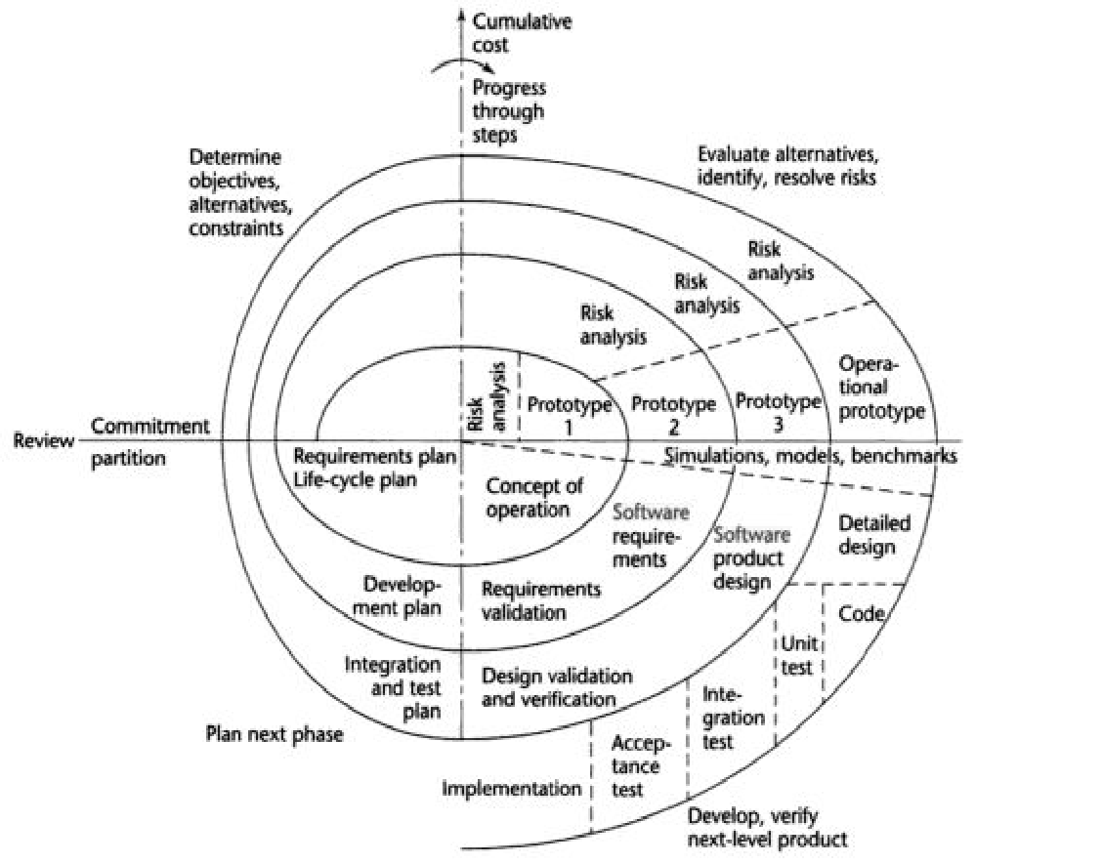
The Spiral Model
Boehm (1988)

Slide 21
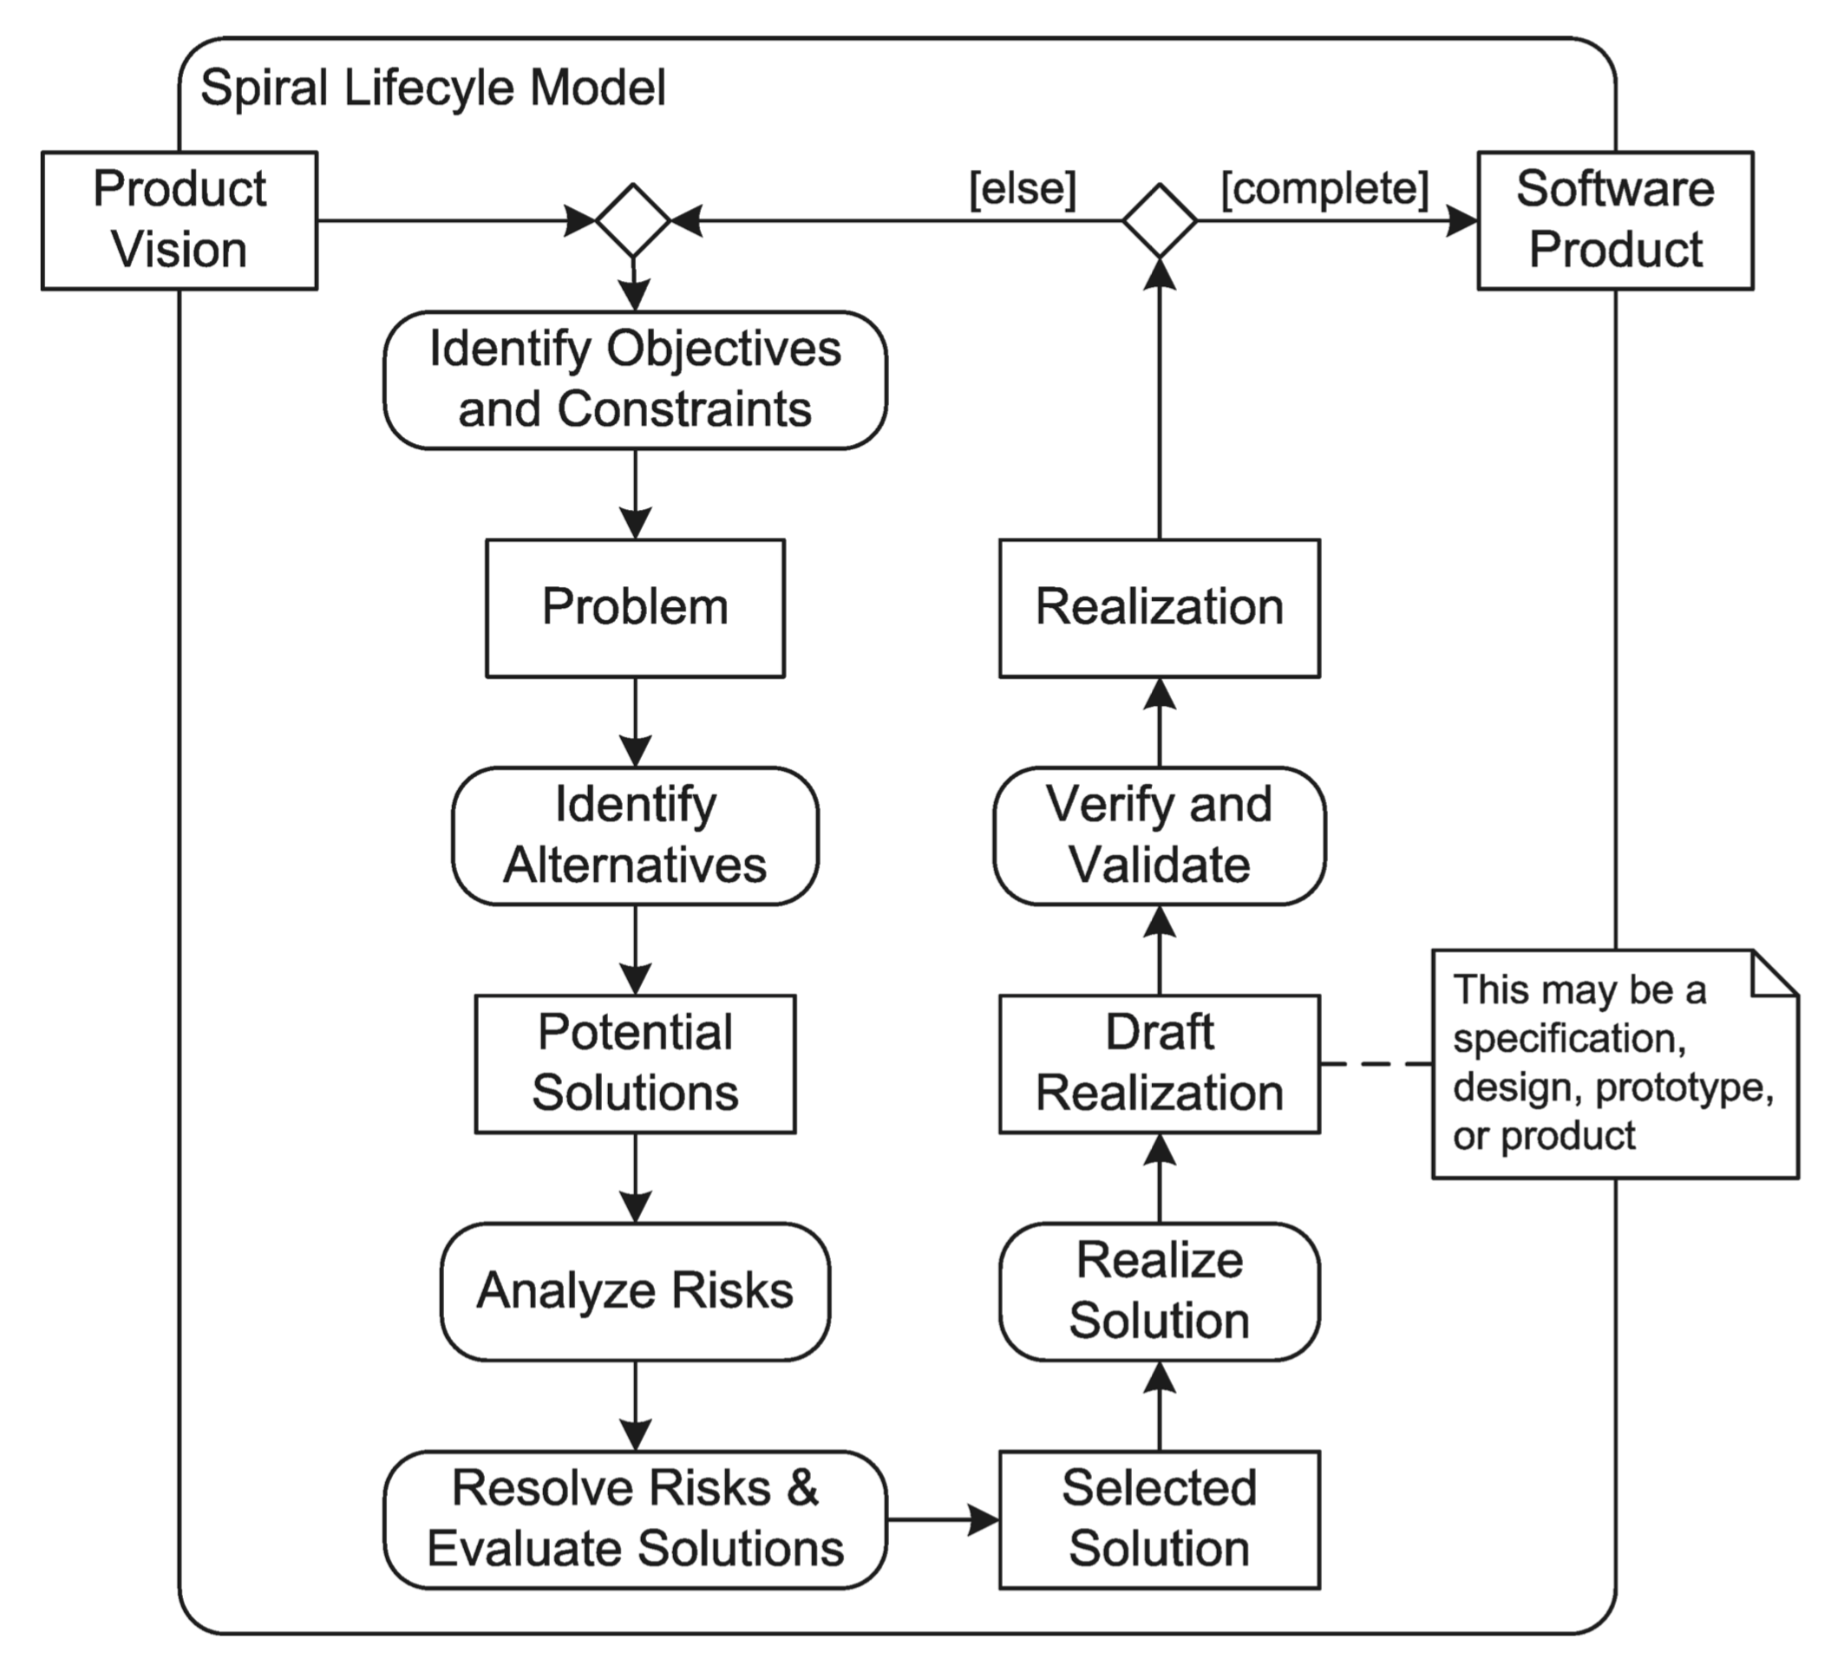
The Spiral Model
Boehm (1988)

Slide 22
The Spiral Model (cont.)
Contributions:
Explicit incorporation of increases in fidelity/detail
Explicit incorporation of risk
One of the early iterative processes
Cons:
Not very many people are trained in and good at risk management
Very general and adaptable, demands expertise in tailoring software processes

Slide 23
Iterative Process
A process that contains one or more repeated tasks

Slide 24
Incremental Processes
Definition:
An incremental process is one that produces its output in phases and the output of each phase is a working version of the software product
Example:
When a customer orders the breakfast special, the chef can first cook and deliver some of the eggs, then cook and deliver the rest of the eggs and the bacon (an incremental process) or cook all of the eggs and bacon and deliver them at the same time (not an incremental process)

Slide 25
Iterative vs. Incremental Software Processes
Iterative Processes:
Any software process can be made iterative and most are naturally iterative
Incremental Processes:
Software processes are sharply distinguished by whether they are incremental (e.g., the waterfall process is not -- the intermediate outputs are not versions of the product)

Slide 26
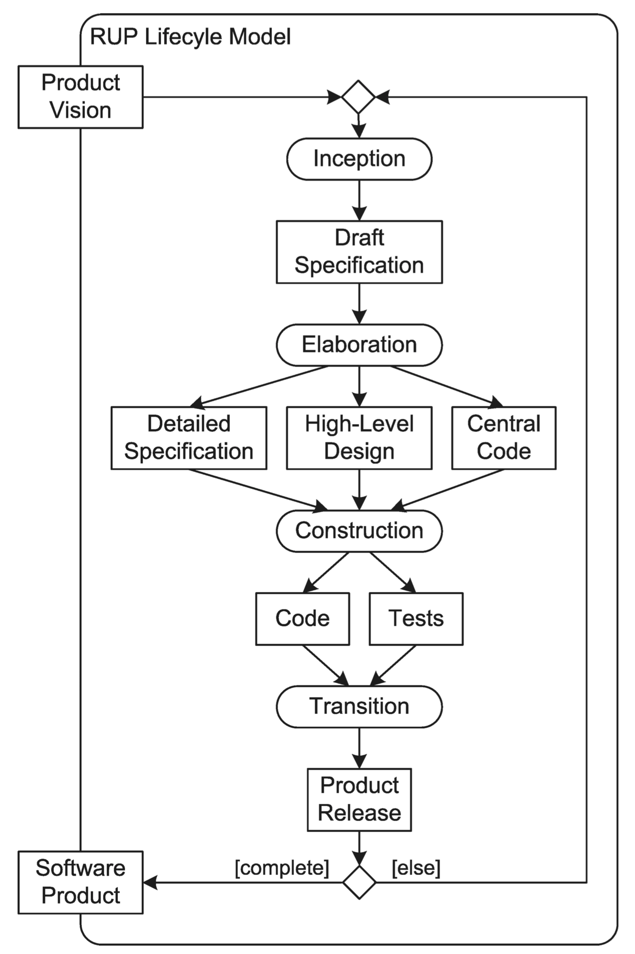
The Rational Unified Process (RUP)
An iterative & Incremental Process
- Jacobson, Booch, Rumbaugh (1999)

Slide 27
RUP Stages
Inception:
Develop use cases
Estimate the schedule and resource requirements
Estimate risks
Create a business case
Elaboration:
Understand the problem domain
Create baseline design
Create test plan
Decide upon metrics
Organize resources

Slide 28
RUP Stages (cont.)
Construction:
Complete the implementation
Release code to α testers
Identify remaining activities
Transition:
Complete the final release
Confirm user readiness and acceptance
Confirm support readiness

Slide 29
The Rational Unified Process (cont.)
Iteration:
Can occur within a phase
Can occur between phases
Core Process Workflows:
Business modeling
Requirements
Analysis and design
Implementation
Testing
Deployment
Configuration and change management
Project management

Slide 30
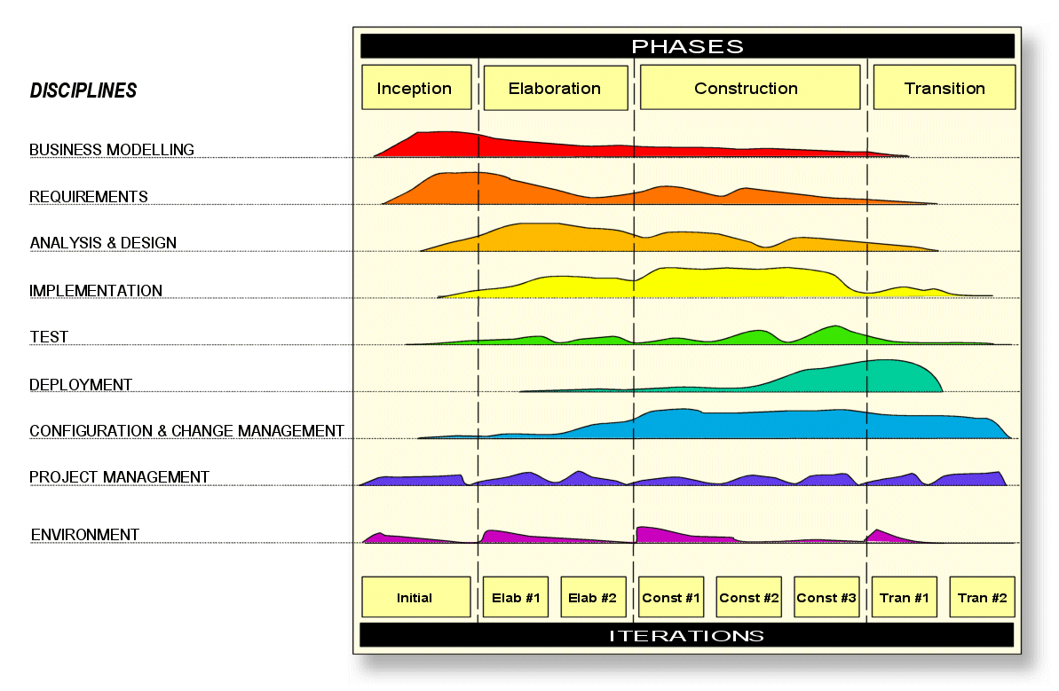

Slide 31
RUP
Pros
Fully specified process, comes with templates
Adaptable to projects of different sizes/needs
Less risk
Getting usable product quickly
Iterative
Cons
Requiring knowledgeable and experienced developers
A lot of documentation and management effort (heavyweight)
Cannot handle requirements change very well

Slide 32
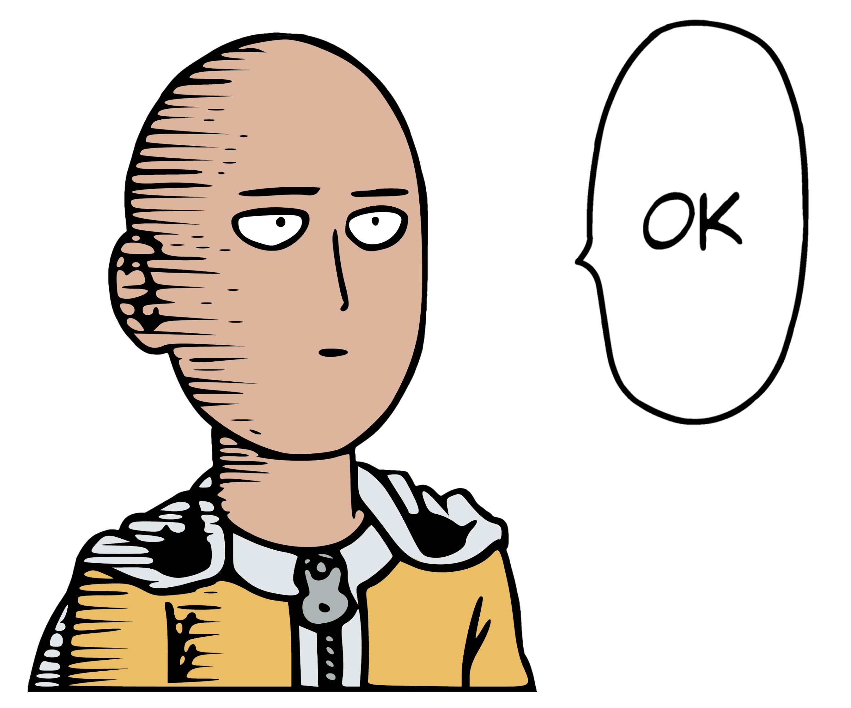
OK, iterative & incremental processes have their strength, but…

Slide 33
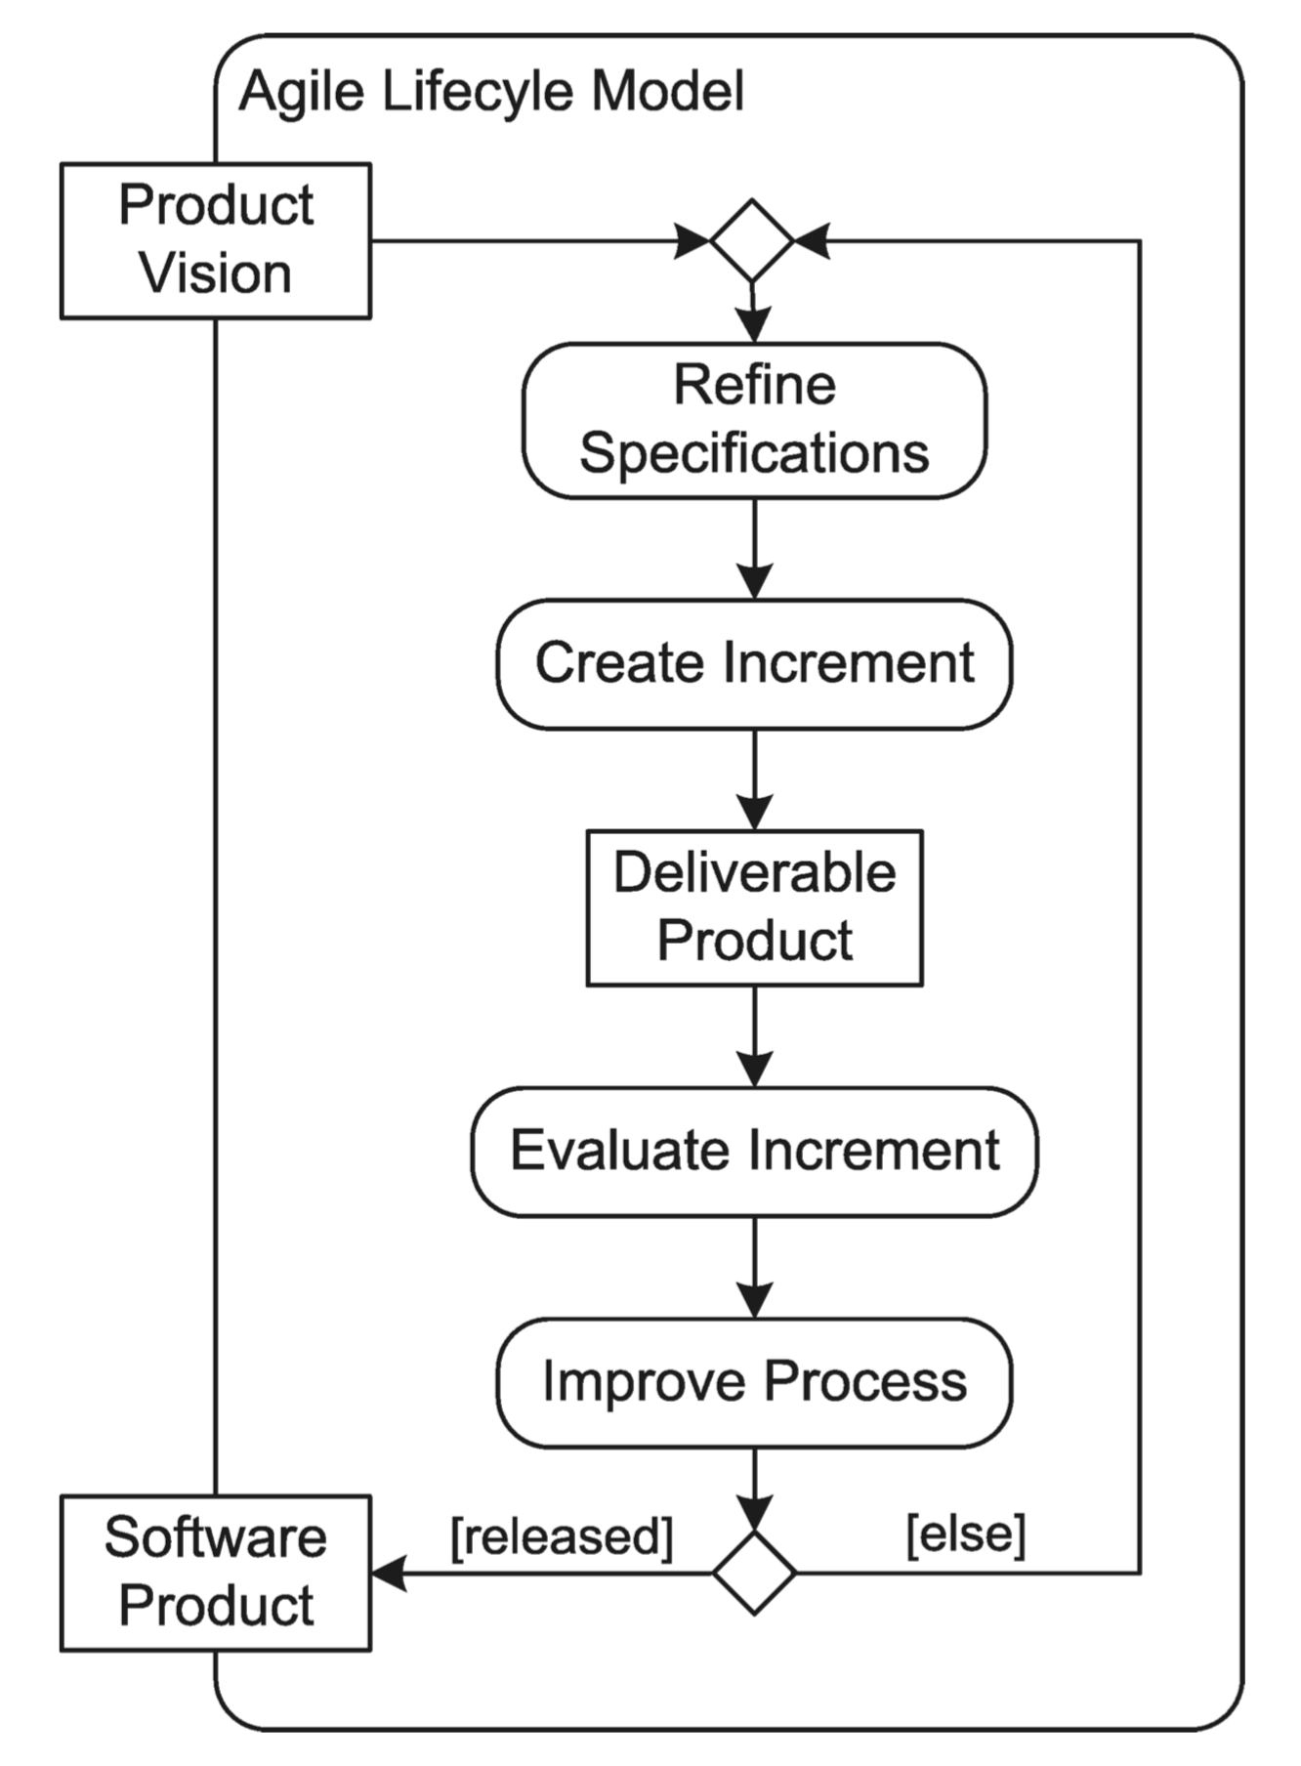
Agile Processes
A Generic Model

Slide 34
Extreme Programming - XP (Beck; 2004)
Basic Principles:
Ensure rapid feedback
Embrace change
Collective ownership
Practices:
Small releases (every release should be as small as possible containing the most valuable business requirements)
Have a metaphor for the project (that replaces the architecture)
Unit tests for every production module and functional tests for features
Make a small initial investment (i.e., the simplest solution that works is the best) and refactor (i.e., improve) later
Pair programming (all production code is written with two people working at one computer; one person thinks about the simplest implementation the other things strategically)
Continuous integration (code is integrated and tested every few hours)
Strict coding standards

Slide 35
Extreme Programming (cont.)
Participants in the Planning Process:
Business
Development
Planning Tools:
Story cards describe the necessary functionality (in the form of a task description) and an estimate of how long the functionality will take to implement
The Planning Process:
Exploration - found out what new things the system could do
Commitment - Decide what subset of all possible requirements to pursue next (Business sorts by value; Development sorts by risk
Steer - Guide the development (involves iteration, recovery, new story construction, and re-estimation

Slide 36
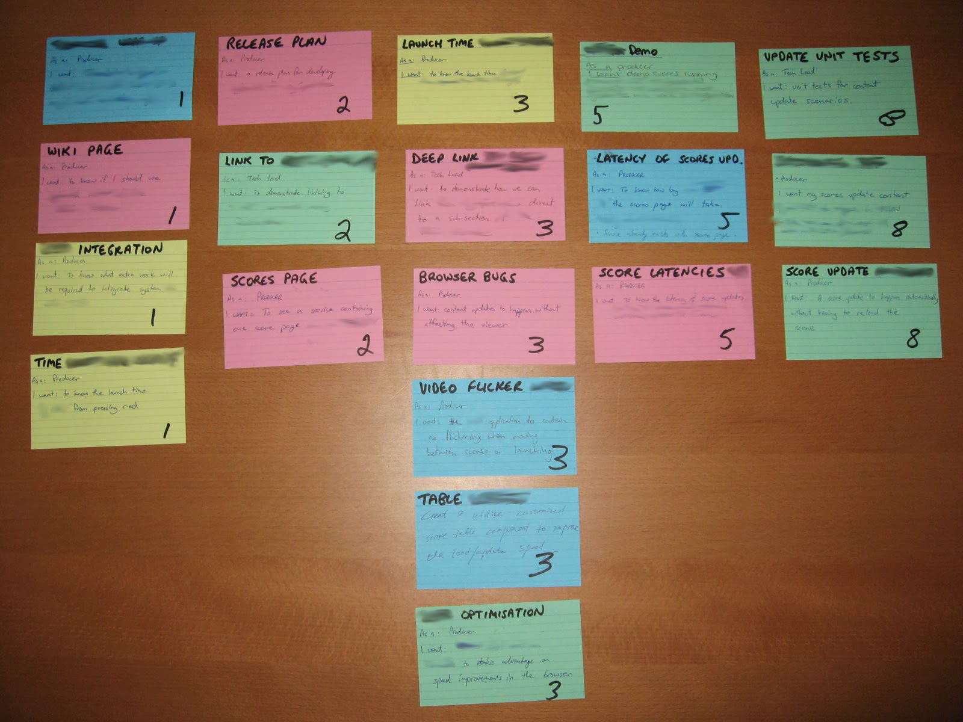
Extreme Programming (cont.)
Story board

Slide 37
Scrum (Sutherland and Schwaber; 1995)
Sprints:
Fixed duration development cycles (usually 1-4 weeks) that end on a specific date (whether the work has been completed or not)
Scrum Roles:
Product Owner (responsible for achieving maximum business value)
Team (multi-functional; 5-10 people)
ScrumMaster (helps the Team be successful; protects the Team)
Process:
Start of the Sprint: There is a Sprint Planning Meeting at which the Team selects items from a prioritized list of requirements/features and commits to completing them
Each Day: Members of the Team report (at a standup meeting of 15 minutes or less) on progress

Slide 38
Scrum (cont.)
Terminology:
The prioritized list of requirements/features is called the Product Backlog
The tasks being completed are called the Sprint Backlog
The daily meeting is called the Daily Scrum
Members of the Team are sometimes called "Pigs" (because they are truly committed to making bacon and eggs) and everyone else is called a "Chicken" (because they are only involved in making bacon and eggs)
Some Details about the Product Backlog:
The Product Backlog includes a rough estimate of the "size"
The Product Backlog also contains developer "to dos", exploratory work, and known bugs
The Product Backlog is updated by the Product Owner

Slide 39
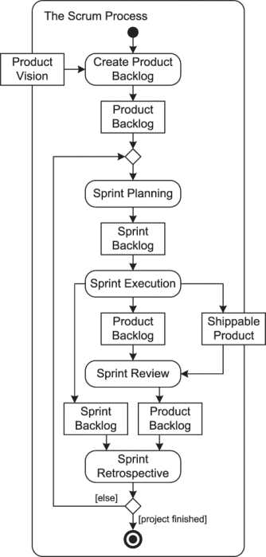
Scrum (cont.)

Slide 40
Scrum - Sprint Planning Meetings
Team members report on their availability
The top item in the product backlog is broken down into tasks that are recorded in the Sprint Backlog
Team members volunteer for the tasks (i.e., take ownership of them) and provide time estimates
The process continues until all available hours are accounted for (Note: Since commitments are being made these meetings can take hours)

Slide 41
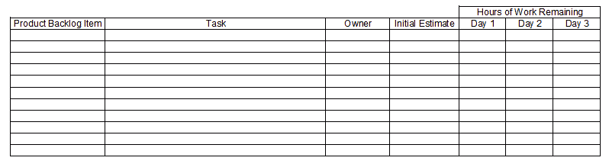
Scrum - Sprints
The team should strive to have a working product at the end of every sprint
The Sprint Backlog contains, at a minimum, the tasks, the name of the task owner, the initial estimate, and the hours of work remaining

Slide 42
Scrum – Sprints (cont.)
Teams often post a Sprint Burndown Chart that graphically illustrates the numbers of hours remaining
It is very important that the team have a definition of "Done" that can be used to assess when work is complete on the current increment

Slide 43
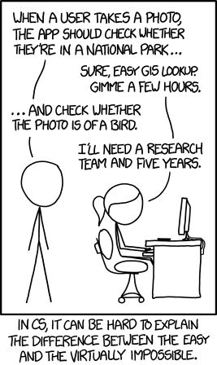
Nerd Humor - From Product Backlog to Sprint Backlog
Courtesy of xkcd

Slide 44
Feature Driven Development - FDD (De Luca; 1977)
The Process:
Develop an overall model
Build a feature list
Plan by feature
Design by feature
Build by feature
Practices:
Individual ownership of classes
Extensive use of code inspections
Regular builds
More reading: http://agilemodeling.com/essays/fdd.htm

Slide 45
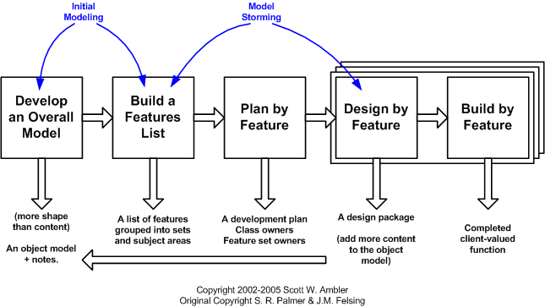
FDD Project Lifecycle

Slide 46
Agile Processes
Pros:
Handle changes very well
Quick delivery of a working product to customer
Can recognize bad projects early (then cancel them)
Reduce waste and duplication of effort
Cons:
Customers and users have to commit time & effort
Incremental design may not be a good thing
Difficult to use on large projects
Hard to predict outcomes

Slide 47
"Heavyweight" vs. "Agile"/"Lean" Methods
A Common Categorization:
Heavyweight: Waterfall, Incremental Delivery, Spiral, RUP
Agile/Lean: XP, Scrum
The Agile Manifesto:
Value individuals and interactions over processes and tools
Value working software over comprehensive documentation
Value customer collaboration over contract negotiation
Value responding to change over following a plan
Another View:
The different process involve the same actions/tasks but vary dramatically in the cycle times

Slide 48
Act 01 Software Processes

Slide 49
Comparison

Slide 50
Comparison (cont.)

Slide 51
Comparison (cont.)

Slide 53
Comparison (cont.)

